Slide 1



Walchand College of Engineering, Sangli
Speed Control of DC motor using PWM
Course: Microcontroller and Peripheral Interfacing
Created by Group 7

Slide 2

Presenters:
Name | PRN
Aditya Pachore | 21410066
Vishvajeet Jagtap | 214110059
Harsh Bandgar | 21410045
Tanuj Joshi | 21410051
Rajwardhan Vichare | 21410058
Guided By: Mr. S.R. Khedkar

Slide 3


Table of Content
Introduction
Objectives
Components Required
Circuit Diagram
Block Diagram
Algorithm
Advantages
Conclusion

Slide 4
Introduction
Aim of developing thus project is to control the speed of dc motor. Advantage of dc motor is speed-Torque relation can be varied almost of any required form .To achieve the speed control an electronic technique Called Pulse Width Modulation is used which generate high & low pulses .Microcontroller is used to generate a PWM using a timer interrupt and the duty cycle as per requirement .
We are also using L298N motor driver Module which can control up to 4 dc motor 2 with direction control and 2 with speed control.

Slide 5
Objectives
1. Configure L298n and 8051 microcontroller.
2. Design algorithm to generate PWM for speed control of DC Motor.
3. Design and implement a user interface for speed control of the DC motor.

Slide 6
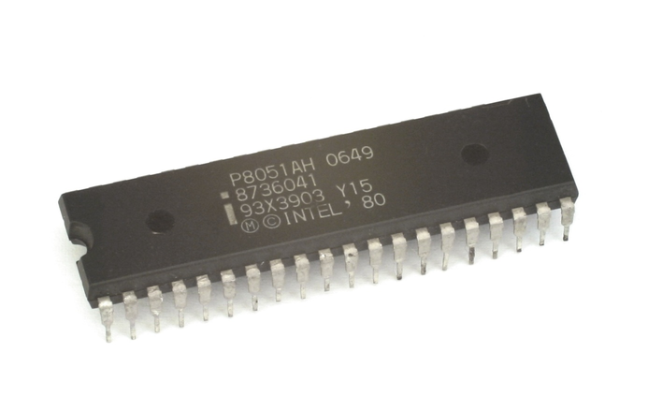
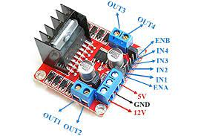
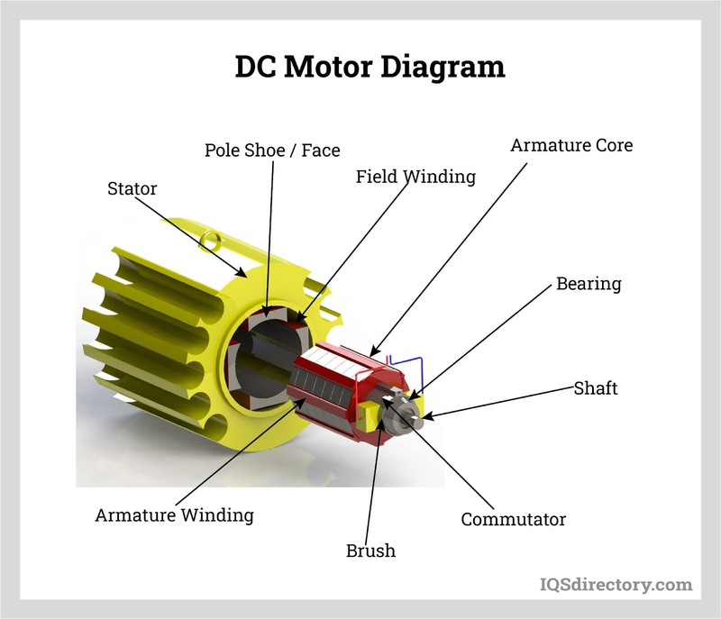
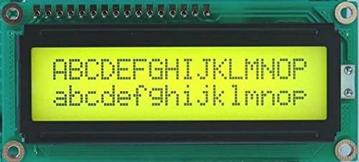
Components
Microcontroller-8051
DC Motor(12V)
L298n Motor Driver
LCD 16*2
Push buttons

Slide 7
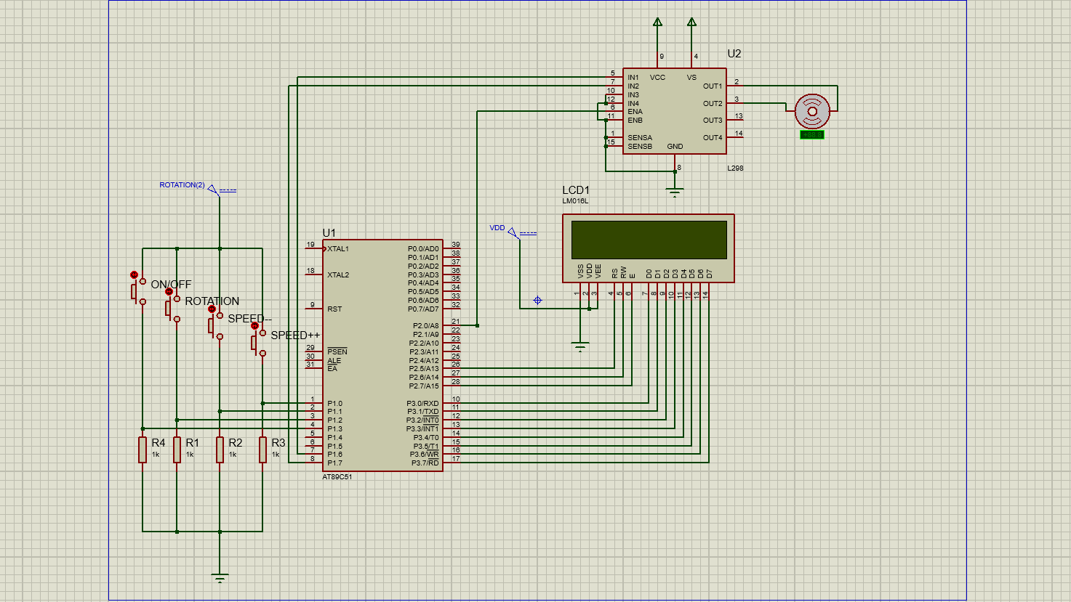
Proteus Circuit

Slide 8
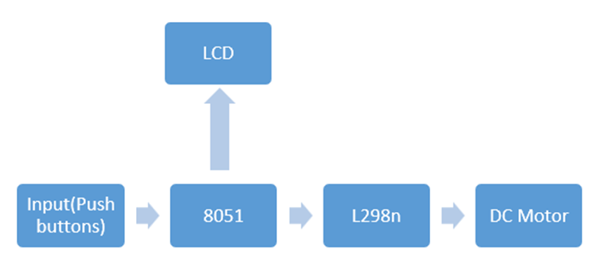
Block Diagram

Slide 9
Algorithm
Configure the timer0 of 8051 in mode 1 for 16-bit timer operation
Calculate the timer0 reload value for the desired PWM frequency
Calculate the duty cycle
Set the duty cycle of the PWM signal
Connect the PWM output pin of the 8051 to a driver circuit that can control the motor speed based on the PWM signal
Initialize the timer0 and start it.

Slide 10
Algorithm
In a loop, vary the duty cycle of the PWM signal by changing the value
Delay for a short period between each change in duty cycle to allow the motor to respond to the new PWM signal
Repeat above steps until the desired motor speed is achieved
Make motor 0

Slide 11
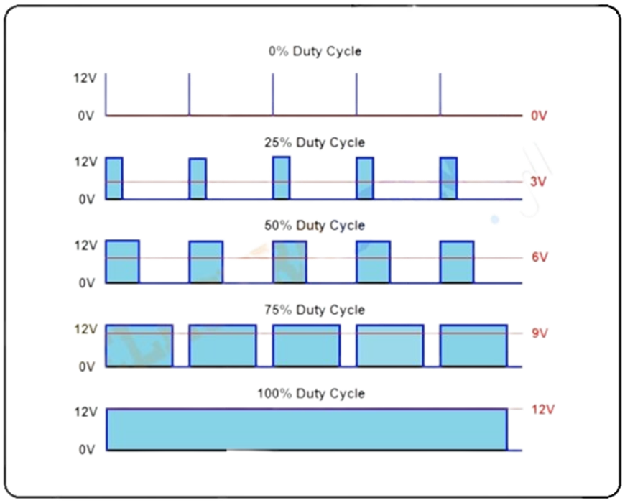
Why PWM?

Slide 12
Various Technique
1)Analog Control
A variable resistor or a potentiometer to vary the voltage supplied to the motor, which in turn, controls the speed of the motor.
2)Frequency Modulation
The frequency of the voltage supplied to the motor is varied, rather than the duty cycle.

Slide 13
Various Technique
3)PWM(Pulse Width Modulation)
Their are two ways to generate pulse width modulation signal using microcontroler :
1)Using timers of 8051'
2)Switch a particular pin high and low.

Slide 14
Advantages of PWM
Efficiency
Precise Control
Low Heat Generation
Easy to Implement
Compatibility

Slide 15
Conclusion

Slide 16
Future Scope:
i)Remote Control Integration
ii)Closed-Loop Control
iii)Multi-Motor Control

Slide 17
Thank You

